Slide 1

YouTube Video Analysis
DAMG 7275 Spring Semester 2022 Final Presentation
Submitted By:
Shweta Gupta (001523739)
Saswato Bhattacharyya (002959396)

Slide 2
Agenda
Introduction
Architecture Diagram
ERD Diagram
Scripts & ETL Process
Scheduling Pipelines
Data Visualization
Future Aspects

Slide 3
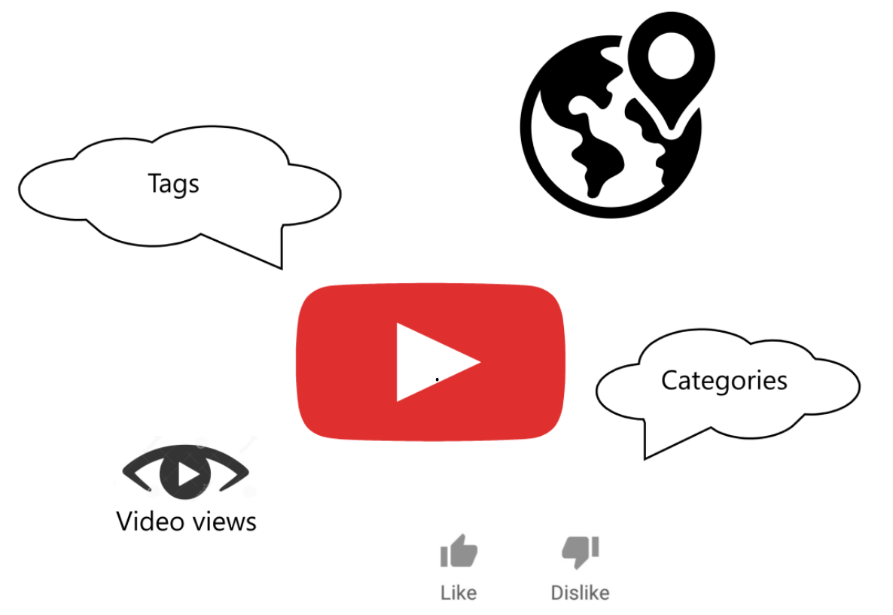
Introduction
A huge repository of terabytes of data is generated each day from modern information systems and digital technologies such as Internet of Things and cloud computing. Analysis of these massive data requires a lot of effort at multiple levels to extract knowledge for decision making.
In this project, we are trying to do create a scalable infrastructure for the YouTube’s video data that will incorporate the videos titles, categories, channels and their timeseries data of likes, dislikes, comment counts and description across 10 countries. This can potentially help us understand ways to improve the performance of the channels and understand what’s trending at a granular level.

Slide 4
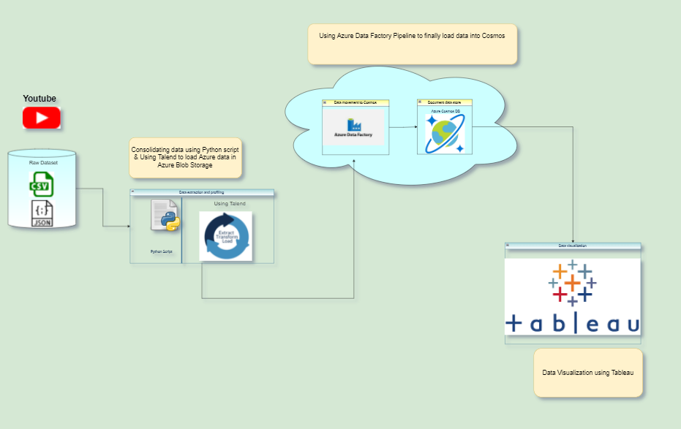
Architecture Diagram
In this dataset, we are given multiple files for 10 different regions across the world, in two formats .JSON & .CSV
Consolidating the data in one files as .JSON format
Loading the data using Talend & Azure data factory
Finally, data visualization using Tableau

Slide 5
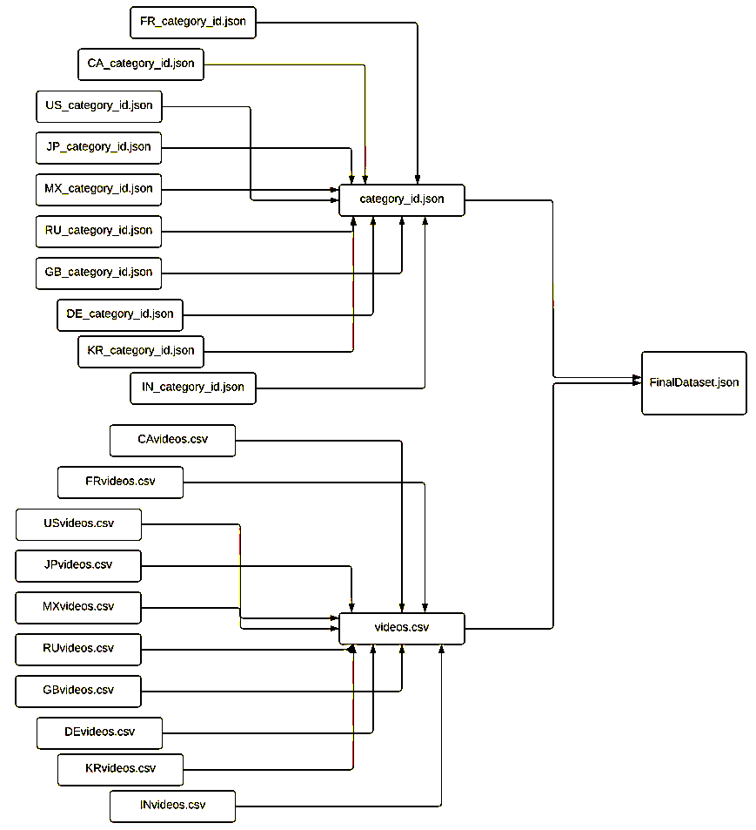

ERD Diagram
Combining the .json data and .csv data
Adding column for region at this level
Now, merging the two files in one FinalDatset.json, using the inner join on Category_id and the Region column

Slide 6
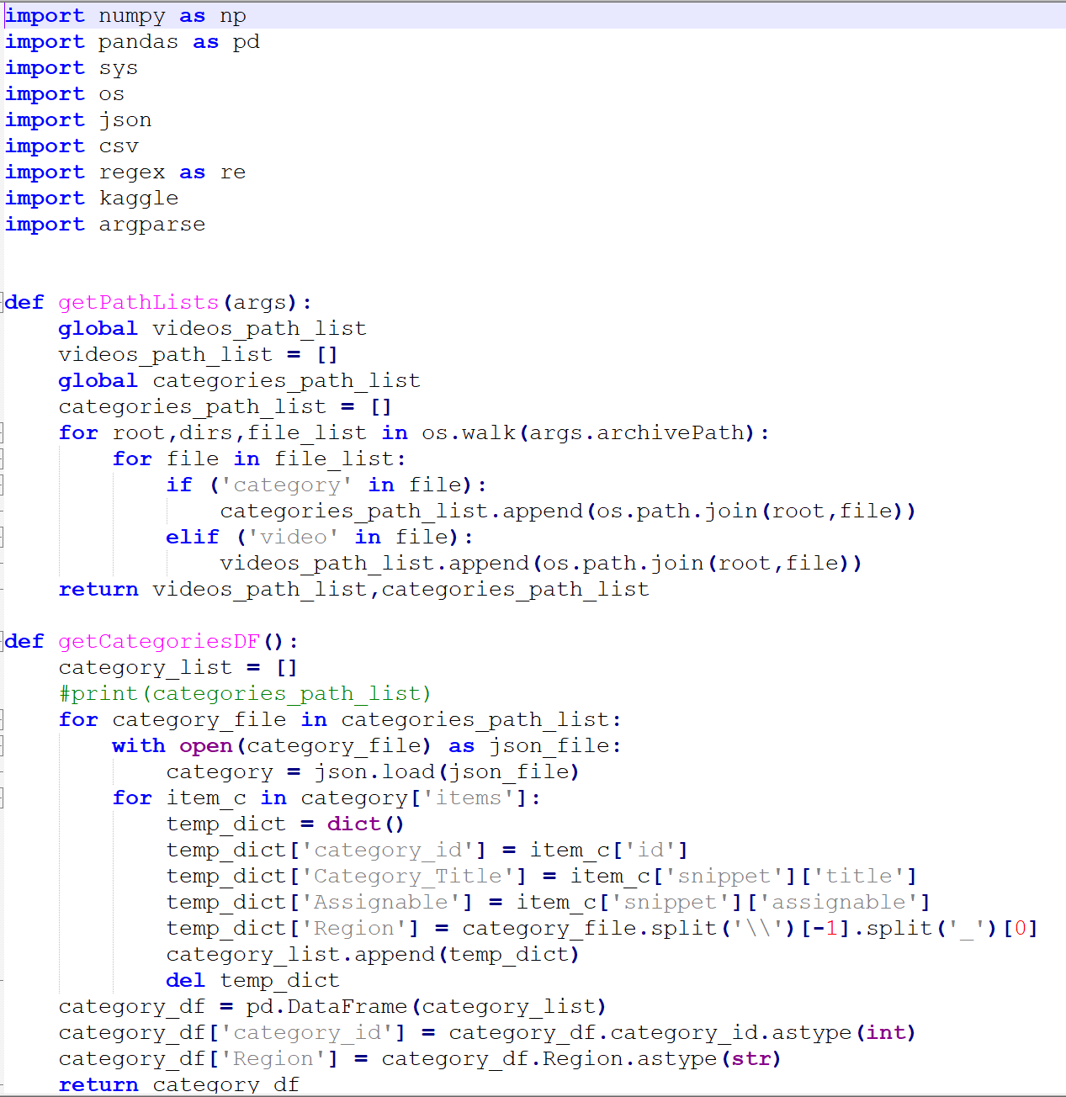
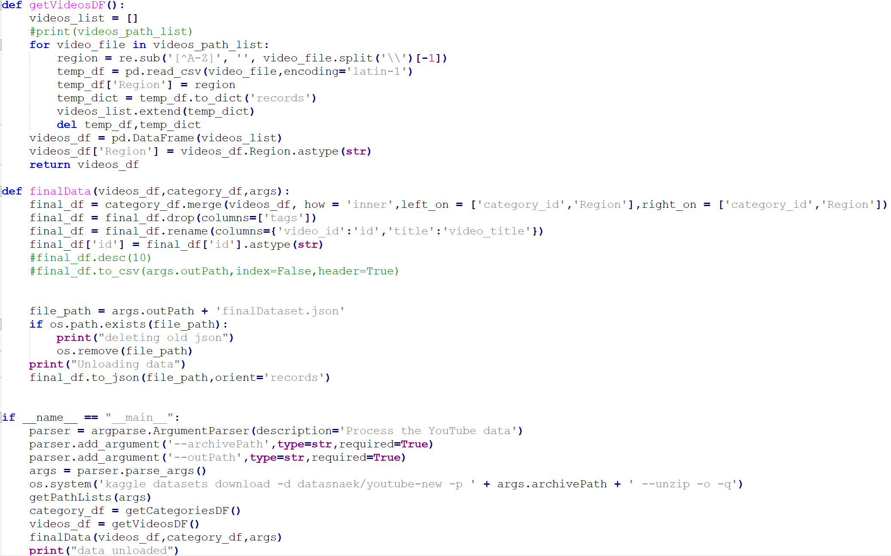
Python Script

Slide 7
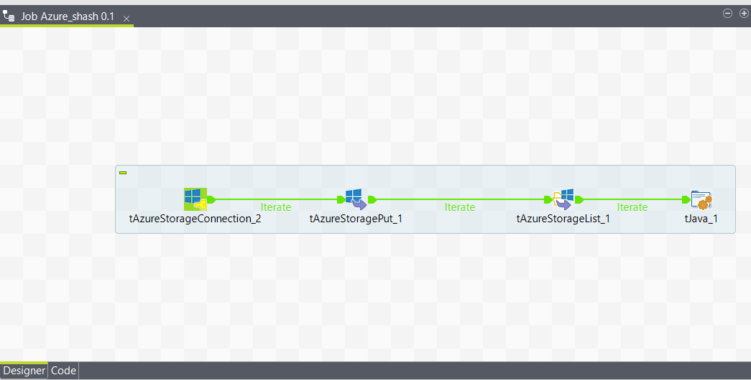
ETL Process (Talend Job)
To transfer On-premise Json file to Azure Blob storage.
The job picks up the file from the source location and places/replaces it in the destination.

Slide 8
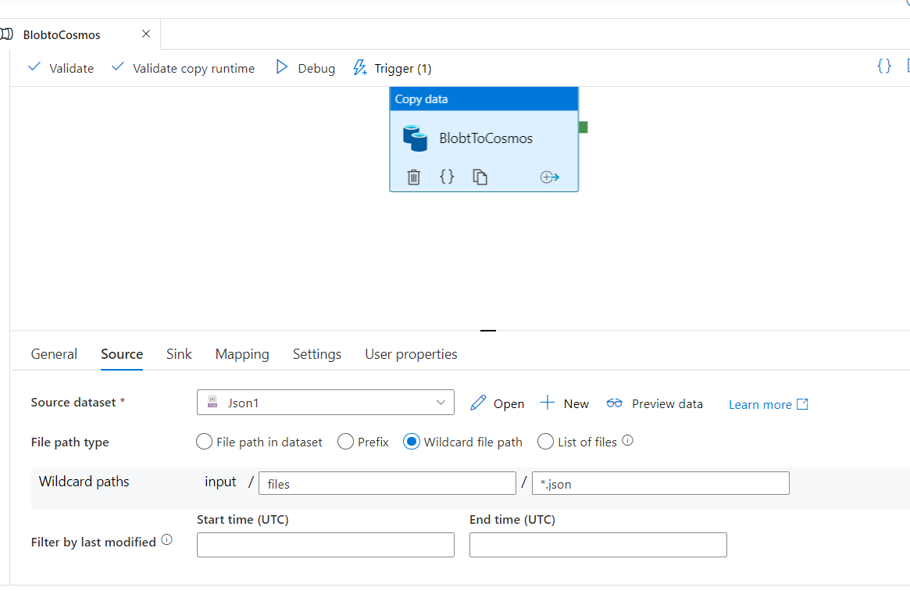
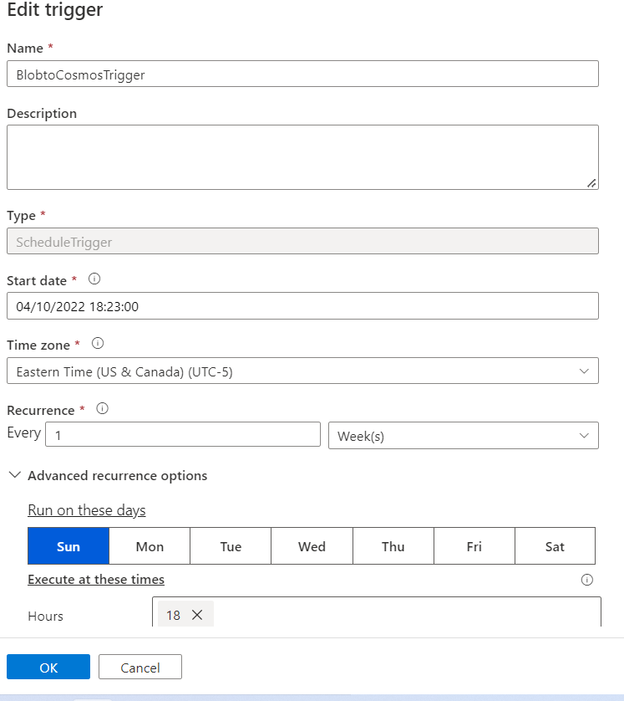
ETL Process (Azure Date Factory)
To migrate data from Azure Blob storage to Azure Cosmos DB.
Use of copy pipeline to upsert data into Cosmos DB.
The job is scheduled using a trigger.

Slide 9
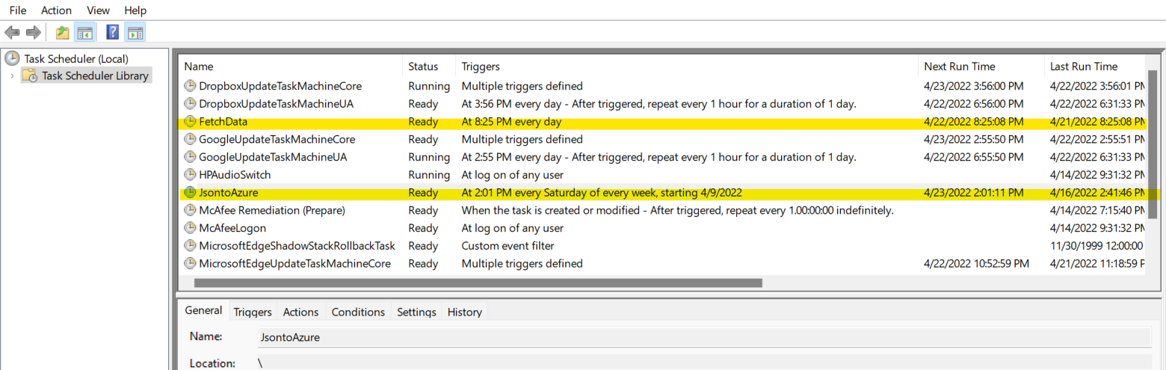
Task Scheduler
We are using Windows Task Schedular to refresh our data on daily basis.
The first job schedules the python script to fetch data from Kaggle and preprocess data while merging into a file.
The second job schedules the Talend ETL to migrate data to Azure Blob storage.

Slide 10
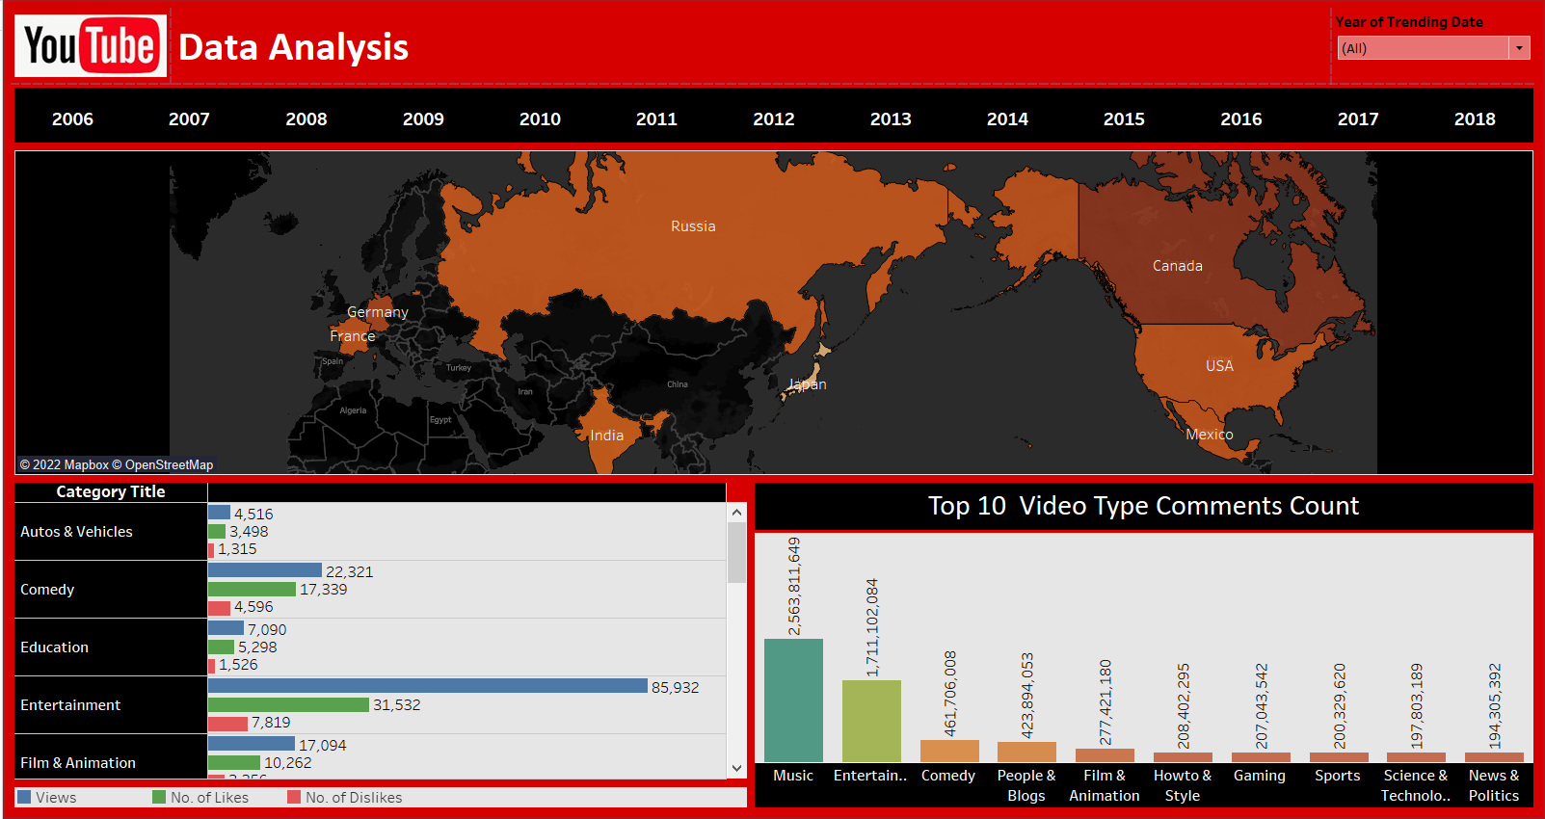
Data Visualization

Slide 11
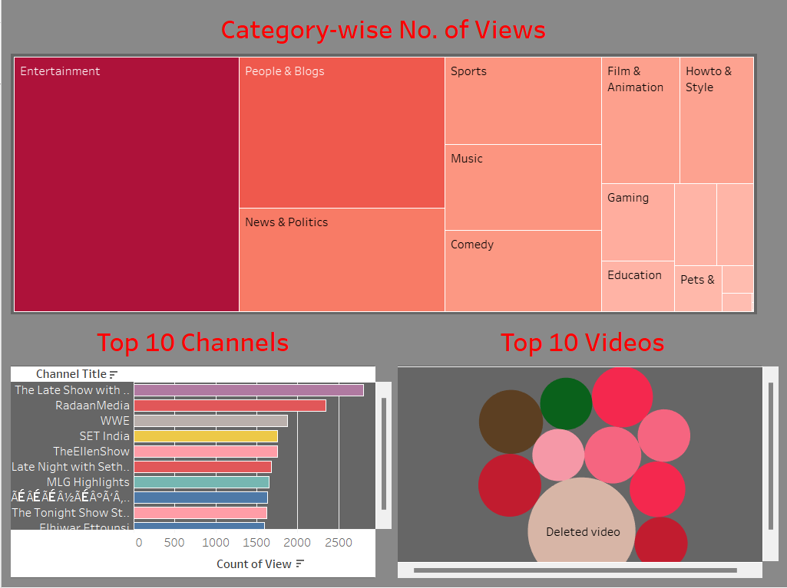
Data Visualization

Slide 12
Future Aspects
Our goal was to create or use code/ tools that can be scalable in future.
For example: The code used to fetch data from Kaggle could handle any additional files from the source.
The further improvements could include the use of Graph database (Gremlin) provided by Azure to fasten the analysis of relationships between entities.
We can also try including data from multiple sources.
Trying to handle the entire integration in a single pipeline.

Slide 13
Thank You .

